Slide 1
Cumming Elementary Schoolwide
Title I Program
2014-2015

Slide 2
What is Title I?
Federally funded program
Receive funds based on % of free & reduced lunch population
Students are served based on academic need.
Title I programs can help:
Children perform better in school.
Teachers understand the needs and concerns of students and parents.
Parents become more involved in their child’s education.
Two types of programs: Targeted Assistance & Schoolwide

Slide 3
Targeted Assistance Program
Targets identified students
Multiple criteria ranked list and documentation required
Funds used for student success in math, reading, language arts, science and social studies only
Qualify if above 35% free & reduced lunch student population
Continuous planning process to target at-risk population
Increased documentation required to ensure only targeted population benefits from funds

Slide 4
Schoolwide Program
Services for ALL students
Focuses on most at-risk students (based on multiple criteria spreadsheet) but all students benefit
Class size reduction allowed
Must have above 40% free & reduced lunch student population
Initial year long planning process with outside technical assistance provided
Funds may be combined with other federal funds for whole school reform and flexibility for the use of the funds
Cumming Elementary has a schoolwide Title I program.

Slide 5
Schoolwide Program
Program Purpose: Support the academic success of students
TINA: Title I Needs Assessment that ranks students as needing additional support- based on several factors including F&P Reading Level, CRCT test scores, and teacher and/or parent request
How Services are Delivered: Push-in or pull-out; during RTI; Cougar Quest (afterschool for qualifying 3-5 students); KinderCamp (for qualifying rising Kindergarten students); Camp Cougar (week-long summer camp for qualifying rising 3-5 grade students)

Slide 6
Georgia’s ESEA Flexibility Waiver
Cumming Elementary is a
2013 Title I Reward School.
A “Highest-Performing School” is a Title I school among the 5% of Title I schools in the State that has the highest absolute performance over three years for the “all students” group on the statewide assessments. A Highest-Performing School must have made Adequate Yearly Progress (AYP) for the “all students” group and all of its subgroups in 2011.

Slide 7
CES Schoolwide Plan
CES Schoolwide Title I Plan drives Title I program.
CES Planning Team includes: Administration, Teachers, LSC members, Feedback from Parents
Student data is analyzed for strengths and needs.
Schoolwide goals are created based on academic needs.
Resources are funded by Title I to support the goals outlined in the schoolwide Title I plan.

Slide 8
Academic Goals
Based on schoolwide academic needs, CES has created the following goals for the 2014-2015 school year:
Increase reading fluency and comprehension
Increase math problem solving skills and computation
Increase science and social studies achievement

Slide 9
Curriculum
Common Core Georgia Performance Standards (CCGPS) is the English language arts and mathematics curriculum in grades K-5.
The standards provide a consistent framework to prepare students for success in college and/or the 21st century workplace.
Georgia Performance Standards (GPS) give clear guidelines for instruction, assessment, and student work.
GPS is the curriculum CES follows for Social Studies and Science.

Slide 10
Academic Assessments
Forsyth County Interim Assessments
Grades 2-5
Pre-Assessment (August 2014)
Post-Assessment (May 2015)
Georgia Milestones
Grades 3-5
Taking the place of CRCT
English language arts, Math, Science, Social Studies
Writing will be a component of all tests
Part of SLOs for 4 & 5
Proficiency Levels: Needs additional support, on track, commendable
Fountas & Pinnell Reading Levels
K-5
Part of SLOs for K-3
Proficiency Level set per grade level by county

Slide 11
How does CES spend Title I funds?
Technology Resources: laptops, iPods, iPads, learning programs
Academic Programs: Imagine It!, Leveled Literacy Intervention, Headsprout, Reading Assistant, math interventions
Learning Games/Materials
Additional Staff
Parent Resource Center

Slide 12
Parent Involvement
The District & School Policies communicate the following goals that promote partnerships with all families:
Open lines of communication between district, school, and home
Numerous opportunities for parents to be involved in decision making and receive guidance to support their Title I child’s academic progress
Ongoing feedback to constantly meet the changing needs of all families in supporting their child’s academic success
The School-Parent-Student Compact communicates goals the school, parent, and student will strive to achieve to ensure academic success for all.

Slide 14
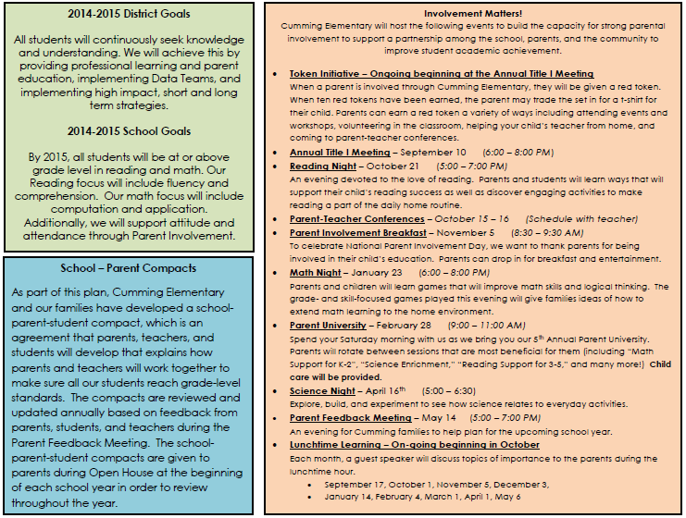

Slide 15
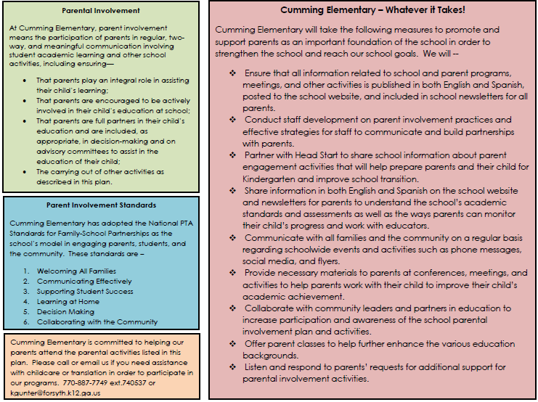

Slide 17
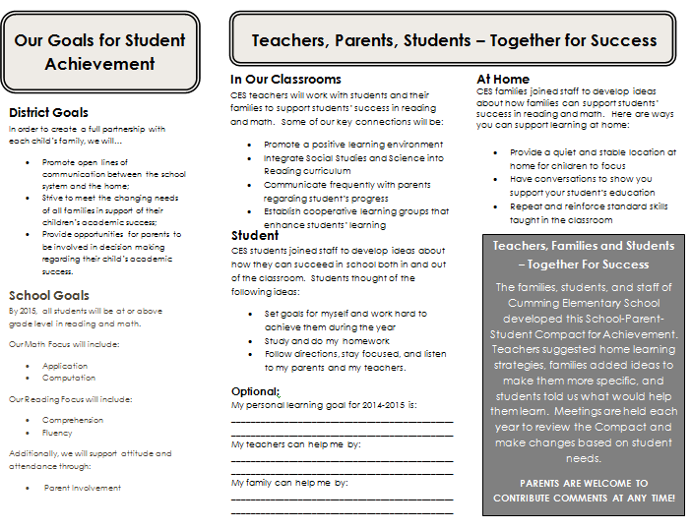

Slide 18
Title I Parent Involvement Funding
Title I schools must set aside money for parent involvement
CES’s parent involvement money is budgeted into different categories, including:
Parent Resources
Take-Home Learning Materials
Translations
Childcare
We value your feedback! Please let us know what resources you would like to help your children grow in their academic success.

Slide 19
Parent Feedback
Parent Involvement Policy
School-Parent Compact
Consolidated Application (Comprehensive Local Education Agency Improvement Plan)
Title I Schoolwide Plan
Parent Surveys (Needs Assessment)
Parent Involvement Set-aside
***Parent feedback may be given online or in written format.

Slide 20
You Have Rights!
The right to know:
All teachers at Cumming Elementary School are highly qualified.
The right to be:
Involved at Cumming Elementary
A decision maker in the education of your child
The right to request:
Parent-Teacher conferences
Meetings to give suggestions

Slide 21
Need more information?
CES Web page http://www.forsyth.k12.ga.us/Page/6658
Information Station –hard copies (located in the CES lobby)
Email/Phone
Forsyth County web page
http://www.forsyth.k12.ga.us/page/316
Cumming Online Parent Resource Center cummingoprc.weebly.com

Slide 22
Title I Contact Information
Kelly Caldwell
kcaldwell@forsyth.k12.ga.us
770-887-7749 ext740252
Katy Gunter (Parent Involvement Coordinator) kgunter@forsyth.k12.ga.us 770-887-7749 ext 740537 Mallory Skinner maskinner@forsyth.k12.ga.us 770-887-7749 ext 740214
Jody Price joprice@forsyth.k12.ga.us 770-887-7749 ext 740818
Natalie Sanfilippo
nsanfilippo@forsyth.k12.ga.us
770-887-7749 ext 740531
Translator for Spanish Speaking Parents
Lucia Quinones-Caraballo LQuinones-Caraballo@forsyth.k12.ga.us 770-887-7749 ext 740518

